Slide 1
BIO 101: Introductory Biology Osinaike T.S. (Lecture C19 –3)
Gametogenesis

Slide 2
GAMETOGENESIS
Gametogenesis is the process of the formation of haploid (n) gamete from diploid (2n) reproductive body.
Gametes are formed by specialized meiosis/reduction division.
Although the male and female gametes are sometimes very dissimilar morphologically (oogamy)- in higher plants and animals, yet both comprise similar phases of sequential changes.

Slide 3
GAMETOGENESIS CONT’D
Gametogenesis is of two types first one is known as microgametogenesis (spermatogenesis) and the second one is megagametogenesis (oogenesis).
Microgametogenesis/spermatogenesis is the process of formation of functional antherozoids –plants and sperm- animals from diploid microsprorocyte/ spermatocyte.
Oogenesis is the formation of haploid egg/ovum from the diploid spore mother cell (megasporocyte)/ oocyte of the ovary.

Slide 4
MICROGAMETOGENESIS:
This is Gametogenesis leading to the formation of male gametes in plants and animals.
In Angiosperms, the most advanced group of plants it occurs in two stages:
Microsporogenesis
Microgametogenesis
Microsporogenesis
The androecium of the plant is made up of the stamen, filament, and anthers.
The pollen grains that carry the male gametes are contained in the anthers.

Slide 5
MICROGAMETOGENESIS CONT’D
The anther is anatomically divided into lobes and the lobes are further divided into chambers called microsporangia.
Pollens present in these microsporangia are known as pollen sac.
It is said that the pollen sac develops from a parent cell known as the archesporial cell.
This archesporial cell divides into outer and inner layers.
The inner layer forms the sporogenous tissue or cell that forms the pollen mother cell.

Slide 6
MICROGAMETOGENESIS CONT’D
This sporogenous tissue is surrounded by the tapetum layer which provided nourishment to the pollen or microspore mother cell present in the sporogenous tissue.
The microspore mother cell is diploid and divides meiotically to form haploid microspores or pollen.
Microgametogenesis
The pollen grain is the haploid cell that is made up of two layers: the outer exine layer which is derived from the tapetum and the inner layer called intine.

Slide 7
MICROGAMETOGENESIS CONT’D
The exine is present all over the pollen grain except in one small part from where the pollen tube emerges during post pollination.
This small part is known as the germ pore. The pollen grain divides into two halves- the small generative nucleus and the larger vegetative nucleus.
The generative cell gives rise to two male nuclei whereas the vegetative cell gives rise to the pollen tube.

Slide 8
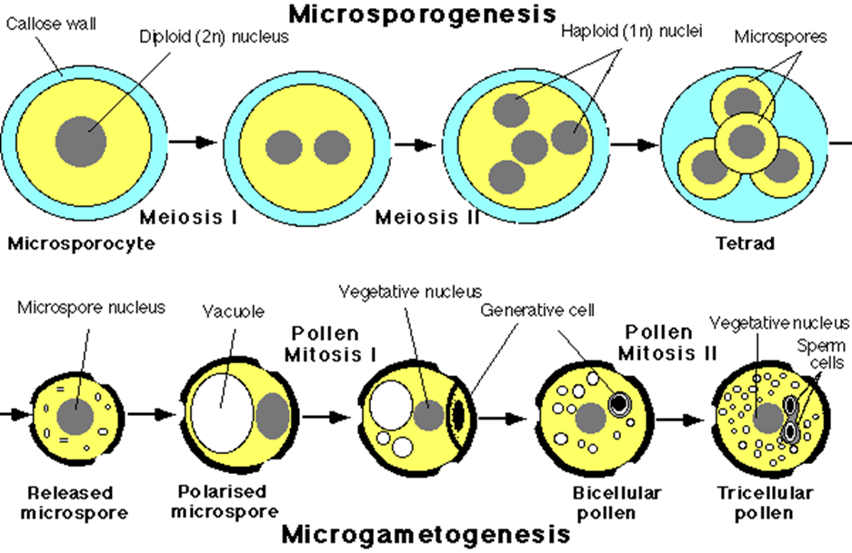

Slide 9
MEGAMETOGENESIS
Megametogenesis in plants is a process leading to formation of the female gametes, like the male gametes, occurs in two stages:
• Megasporogenesis
• Megagametogenesis
The word ‘mega-‘ is used instead of ‘micro-‘ in females because the female gametes are larger in size as compared to the male gametes.

Slide 10
MEGAMETOGENESIS CONT’D
Megasporogenesis
In Angiosperms the ovules are present inside the ovary in multiple lobes.
A cell in the ovule differentiates into a megaspore mother cell.
The megaspore mother cell is diploid.
This megaspore mother cell undergoes meiosis to form 4 haploid megaspores.
3 of the 4 megaspores degenerate and only one megaspore is left in each ovule.

Slide 11
MEGAMETOGENESIS CONT’D
Megagametogenesis
This megaspore nucleus now begins to divide mitotically to form 8 nuclei.
6 of the 8 nuclei migrate to opposing poles (3 each) while two nuclei remain at the center.
The nuclei that remain at the center are known as polar nuclei.
These polar nuclei fuse to form the secondary nucleus. The megaspore matures into an embryo sac.

Slide 12
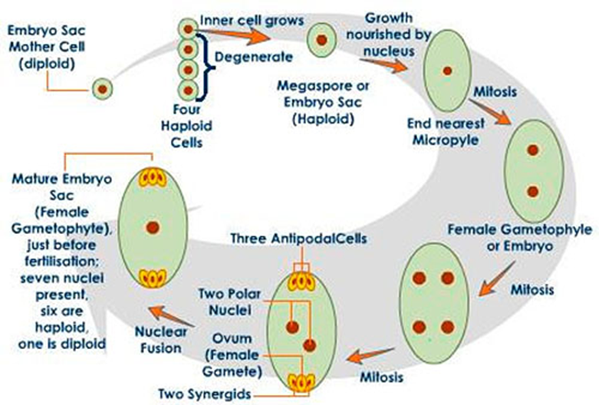

Slide 13
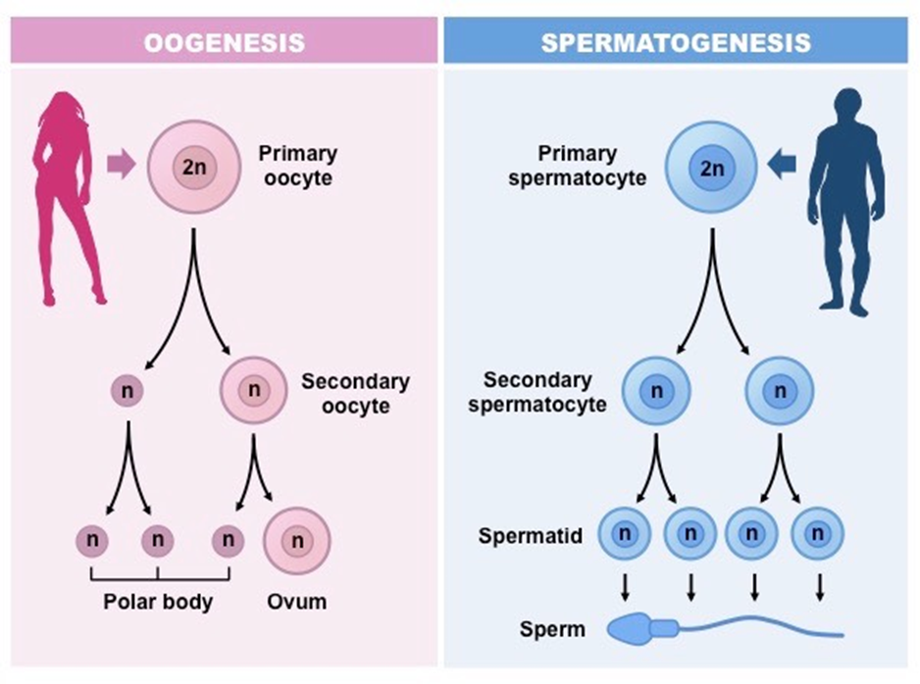
DIAGRAMMATIC REPRESENTATION OF GAMETOGENESIS IN ANIMALS E.G. HUMAN

